Slide 1
Why are the rich countries, rich, and the poor, poor?
A work by: Pyth@nes

Slide 2
Sure, the simplest way of defining a country as rich or poor is by gdp per capita…

Slide 3
High income per capita =

Slide 4
Low income per capita =

Slide 5
Ehmm…that’s obvious

Slide 6
But why those countries?

Slide 7
Core question 1
What is the factor that makes Norway one of the richest and Haiti one of the poorest?

Slide 8
Bangui, Central African Republic
Is there something more?
Or this just the consequence of history?
Auckland, New Zeland

Slide 9
So… which element of a country does not depend of the actions of its population?
Notes:
Borrar esto

Slide 10
Geography

Slide 11
Core question 2
HYPOTHESIS
Are latitude (Ecuator) and longitude (Greenwich) related to wealth?

Slide 12
HYPOTHESIS
There is a correlation between a country’s coordinates and its level of wealth.

Slide 13
Resources
World Bank
World Transparency
Google (API)

Slide 14
DATA EXPLORATION
- Datasets: GDP, Transparency, Coordinates, Religion.
- Google API
- Data cleansing.
- Data merge.
- Graphics and Matplotlib
- Conclusions (blew it out of the water)

Slide 15
DATA Analysis
- We did several plotting trials in order to find those plots whose information provided an easier chance to display in an understandable way.
- Finally we discussed the findings.

Slide 16
Findings

Slide 17
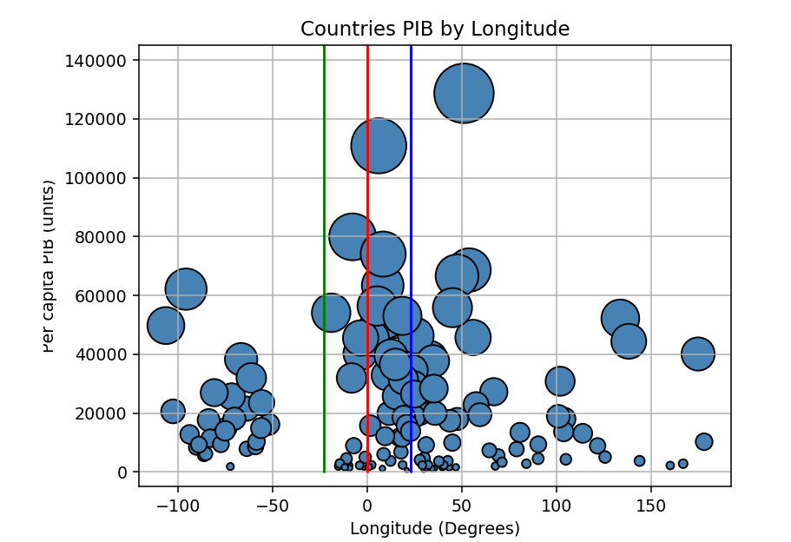

Slide 18
While the position of a country regarding the Greenwich line did not show any evident correlation

Slide 19
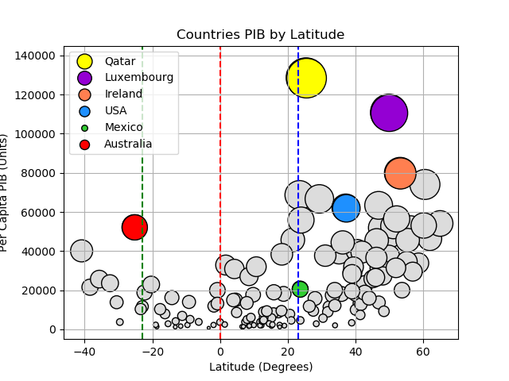

Slide 20
As the distance with the Ecuador is bigger, so is the size of the countries GDP.

Slide 21
Lets see two different variables that are related to both GDP and coordinates.
Transparency index vs annual temperature average

Slide 22
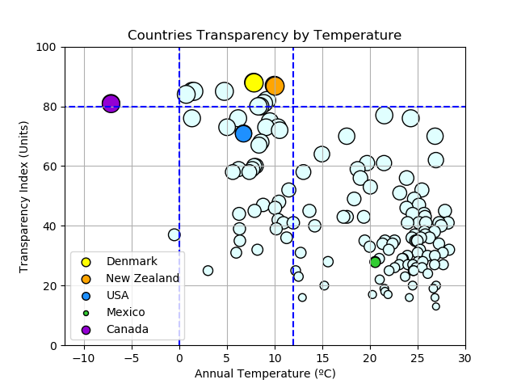

Slide 23
Temperature has an influence in transparency

Slide 24
If cooler countries are more transparent, what about the GDP vs. Transparency?

Slide 25
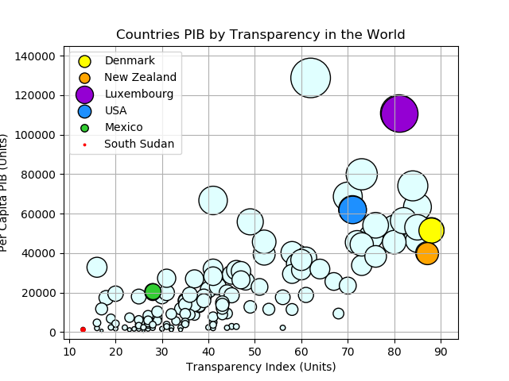

Slide 26
More transparent countries have higher GDP per capita.

Slide 27
Conclusion

Slide 28
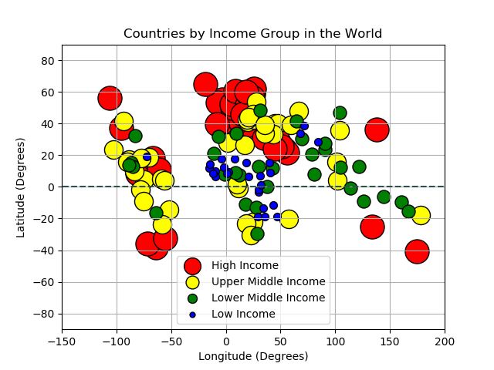

Slide 29
Conclusions
- The closer to the equator, the lower the GDP per capita.

Slide 30
Conclusions
- Taking into consideration that as a country is closer to the Ecuador, its annual temperature average is higher than those who are further away:
The hotter the country is, the less transparent it is.
The colder the country is, the more transparent it is.
As a country tests higher in the transparency index, its GDP is bigger.
As a country tests lower in the transparency

